Slide 1
Microsoft Power BI

Slide 2
ALM in Power BI with Deployment Pipelines
Ted Pattison
Principal Program Manager
Power BI Customer Advisory Team (PBICAT)

Slide 3
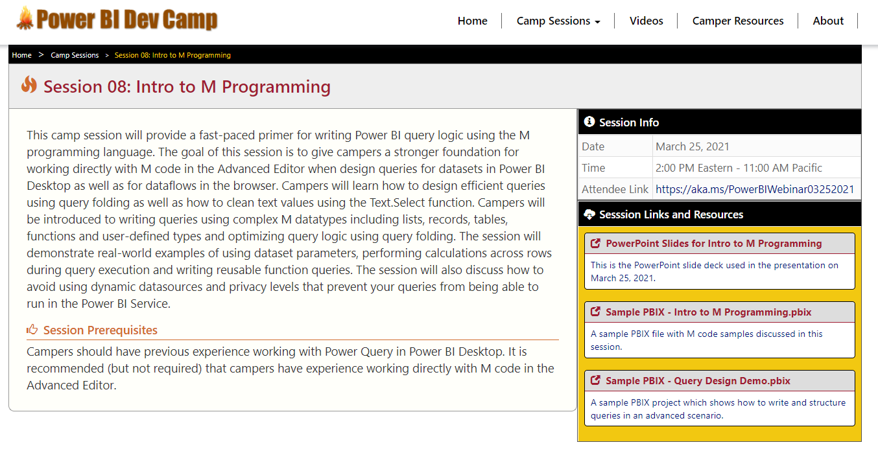
Welcome to Power BI Dev Camp
Power BI Dev Camp Portal - https://powerbidevcamp.net

Slide 4
Agenda
Introduction to Deployment Pipelines
Building and Versioning Power BI Artifacts
Publishing Artifacts to the Power BI Service
Creating and Configuring Deployment Pipelines
Writing Code to Create and Manage Deployment Pipelines
Pipelines Roadmap

Slide 5

What Are Dev Ops and CI/CD ?
What is Dev Ops?
Set of practices that integrate software development (Dev) together with IT operations (Ops)
Strategy to shorten the life cycle for delivering updates while maintaining high quality
Based on Agile development which promotes pushing updates in small incremental changes
What is Continuous Integration (CI)?
Strategy to integrate source code and deployment artifacts into shared repository with version control
What is Continuous Delivery (CD)
Strategy to deploy new features, upgrades & bug fixes into production as soon as possible
Shared Repository
with version control
Automated Build/Test
with Azure DevOps
Operations
Production
Environment
Dev 1
Application Code v1
Build
Process
Application Code v2
CI
Application
CD
Application
Dev 2
Library Code v3
Library Code v2
Library Code v1

Slide 6
Managing DevOps CI\CD in a Power BI Environment
Content authors publish artifacts to shared repository with version control
Artifacts are deployed to Power BI workspace using Power BI REST API operations
Requires choosing a source control system for Power BI artifact source files
GitHub, Azure DevOps, OneDrive, SharePoint, etc.
Shared Repository
with version control
Power BI Workspace
Dataset Creator
Power BI Dataset v4
import
Power BI Dataset
Power BI Dataset v3
Power BI Dataset v2
Power BI Dataset v1
Report Creator
Power BI Report v4
import
Power BI Report 1
Power BI Dataset v3
Power BI Dataset v2
Power BI Dataset v1
Report Creator
Power BI Report v3
import
Power BI Report 2
Power BI Dataset v2
Power BI Dataset v1

Slide 7
ALM in Power BI with Deployment Pipelines
ALM features based on CI/CD of Power BI artifacts
ALM = Application Artifact Lifecyle Management
Power BI artifacts include datasets, reports, dataflows and dashboards
Pipeline contains 3 workspace stages for Dev, Test and Prod
Pipelines automates deployment of artifacts across stages
Power BI Deployment Pipeline
Source Control System
Dev Workspace
Test Workspace
Production Workspace
Power BI Artifact 1
Power BI Artifact 1
Power BI Artifact 1
Power BI Artifact 1
import
deploy
deploy
Power BI Artifact 2
Power BI Artifact 2
Power BI Artifact 2
Power BI Artifact 2
Power BI Artifact 3
Power BI Artifact 3
Power BI Artifact 3
Power BI Artifact 3

Slide 8
Understanding Deployment Pipeline Stages
Dev Stage Workspace
Import artifacts, create dashboards, test basic functionality
Test Stage Workspace
Share content with testers and reviewers
Run user experience tests and performance tests with larger volumes of data
Production Stage Workspace
Used to serve content to main user base
Power BI Deployment Pipeline
OneDrive SharePoint
Dev Workspace
Production Workspace
Test Workspace
Power BI Dataset
Power BI Dataset
Power BI Dataset
GitHub
import
deploy
deploy
Power BI Report
Power BI Report
Power BI Report
Azure DevOps
Power BI Dashboard
Power BI Dashboard
Power BI Dashboard

Slide 9
Configuring Deployment Pipeline Stages
Each stage has an associated workspace
Workspace membership/permissions can be configured independently for each stage
Datasets in each stages can connect to different datasources via Deployment Rules
Workspace for any stage can be published as a Power BI App
Power BI Deployment Pipeline
Dev Workspace
Test Workspace
Production Workspace
Power BI Report 1
Power BI Report 1
Power BI Report 1
Power BI Report 2
deploy
Power BI Report 2
deploy
Power BI Report 2
Power BI Dataset
Power BI Dataset
Power BI Dataset
Dev DB
Test DB
Production DB

Slide 10
Demo Creating a Deployment Pipeline

Slide 11
Deploying Content from Stage to Stage
Deploying to an empty stage
First deployment creates workspace and requires capacity permissions to succeed.
All content is cloned with the same connections between items.
Reports connected to external dataset will remain connected after deploy
Initial deployment can be pushed to next stage (forwards) or previous stage (backwards)
Deploying to a populated stage
Updated items will override the content of their counterparts.
‘Deploy to previous stage’ is not available
Dev Workspace
Test Workspace
Production Workspace
Power BI Artifact 1
Power BI Artifact 1
Power BI Artifact 1
Power BI Artifact 2
deploy
Power BI Artifact 2
deploy
Power BI Artifact 2
Power BI Artifact 3
Power BI Artifact 3
Power BI Artifact 3

Slide 12
What attributes are deployed?
Copy & override
No copy, no override
Copy with rules
Report visuals
Report pages
Dashboard tiles
Model metadata
Item relationships
RLS Role Definitions
Auto Aggregations
Inc Refresh Policy
Sensitivity labels * * unless they exist in target
Data
Artifact IDs and URLs
Workspace Permissions
Workspace settings
App content and settings
Refresh schedule
RLS role assignment
Inc Refresh Partition
Datasources
Parameters

Slide 13
Agenda
Introduction to Deployment Pipelines
Building and Versioning Power BI Artifacts
Publishing Artifacts to the Power BI Service
Creating and Configuring Deployment Pipelines
Writing Code to Create and Manage Deployment Pipelines
Pipelines Roadmap

Slide 14
Source Code Definitions for Power BI Artifacts
You must learn how to build and upgrade artifact source files
Different types of Power BI artifact use different file formats
Icon | Artifact Type | File Formats | Supports Parameters
 | Dataset | PBIX or BIM | Yes
 | Report | PBIX | No
 | Paginated Report | RDL | No
 | Dataflow | JSON | Yes
 | Dashboard | N/A | No
Artifact Source Files

Slide 15
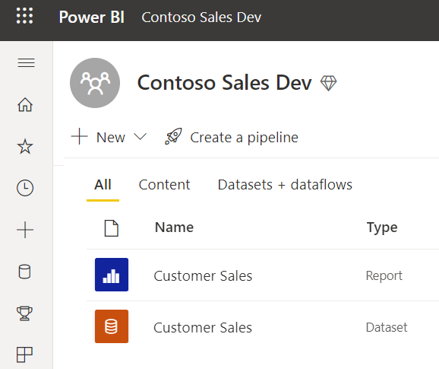
Building a Dataset and Report in Single PBIX File
Provides simplest and most-common approach
Single PBIX file does not allow multi-authoring
Updates for dataset and report can be separated
Single PBIX Scenario
Report Layout
Dataset Definition
Import
Customer Sales.pbix

Slide 16
Building Datasets & Reports in Separate PBIX Files
Dataset definition stored in separate PBIX file
Reports defined using satellite PBIX files with Live Connect to dataset
All PBIX files can be updated, versioned and updated independently
Requires rebinding report to dataset after import operation
Separate Dataset PBIX from Report PBIXs
Report Layout
(not used)
Report Layout
Dataset Definition
Product Sales Report.pbix
Product Sales Model.pbix
Report Layout
Top 10 Products.pbix

Slide 17
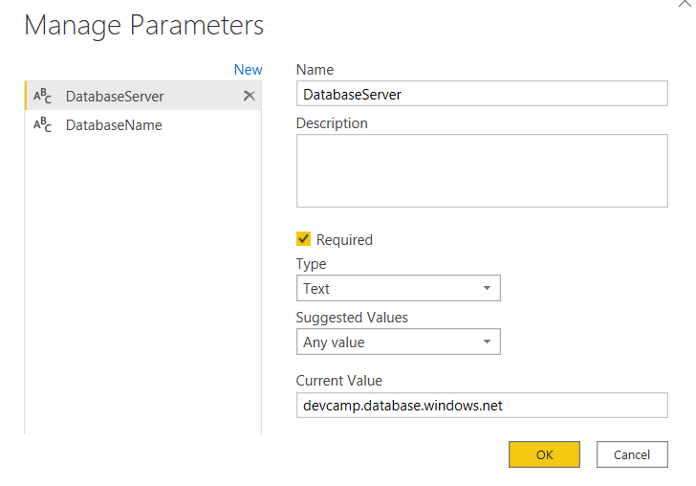
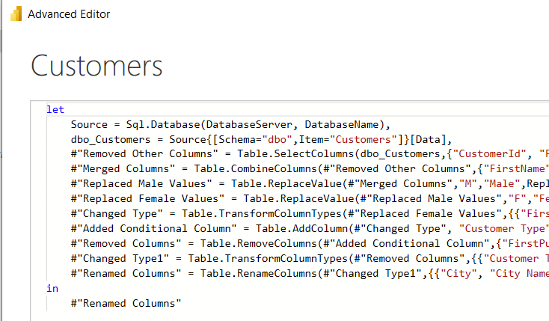
Designing Datasets with Parameters
What is a Dataset Parameter?
Configurable project-level setting for PBIX file
Strongly-typed value to which you can apply restrictions
Can be referenced from a query to determine datasource path
Dataset parameters can be updated in Power BI Service by hand or through API
Notes:
In the summer of 2016, the Power BI team added new support to Power BI Desktop so that you can create configurable parameters within the scope of a Power BI Desktop project. The two primary scenarios for creating project parameters is to parameterize data source settings and to parameterize filter criteria used in queries.

Slide 18


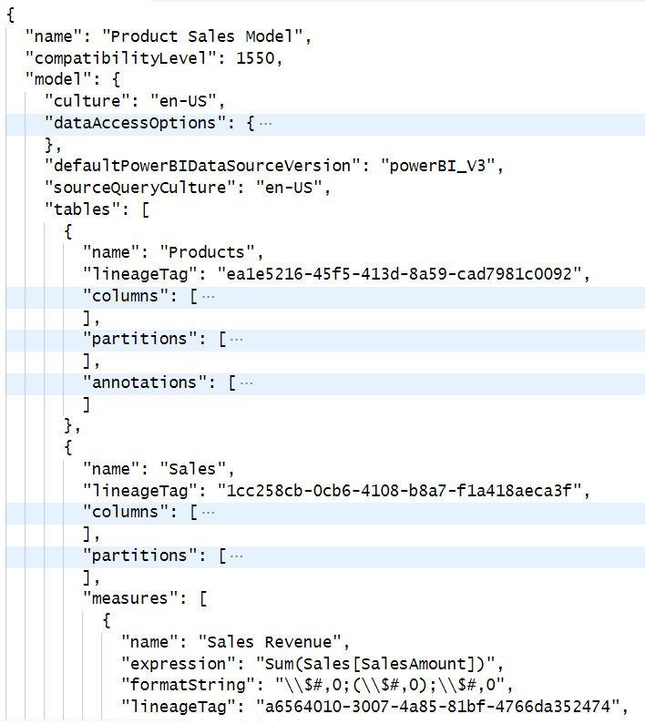
Developing Datasets using BIM Files
Dataset definitions can be maintained/developer using JSON-based BIM file format
Dataset definitions edited using external tools (e.g. Tabular Editor) or API (e.g. TOM)
Reports defined using satellite PBIX files with Live Connect to dataset
Requires rebinding report to dataset after import operation
Maintain Dataset Definition using BIM File Format
SSDT
Report Layout
Dataset Definition
Product Sales Report.pbix
Report Layout
Product Sales Model.bim
Top 10 Products.pbix

Slide 19
Viewing DIFFS Between BIM File Versions
Add Azure DevOps Repo diff

Slide 20
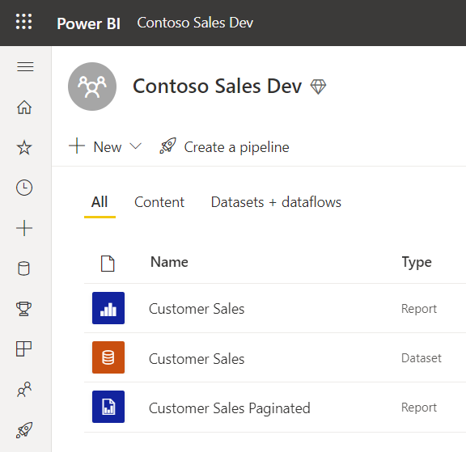
Building Paginated Reports
Paginated reports authored using Power BI Report Builder
Provides more control over printing/export process
Paginated report saved into XML-based RDL file

Slide 21
Deploy Dataflows
Dataflows can be created/edited in Power BI Service using browser
Dataflows can be exported/imported using JSON file format
Power BI Service API support importing JSON to create dataflow

Slide 22
Agenda
Introduction to Deployment Pipelines
Building and Versioning Power BI Artifacts
Publishing Artifacts to the Power BI Service
Creating and Configuring Deployment Pipelines
Writing Code to Create and Manage Deployment Pipelines
Pipelines Roadmap

Slide 23
Power BI REST Operations used in Deployment
Imports
How do you use them?
Use PowerShell
Call Power BI REST API
Use Power BI .NET SDK
Use Azure DevOps extension named Power BI Actions

Slide 24
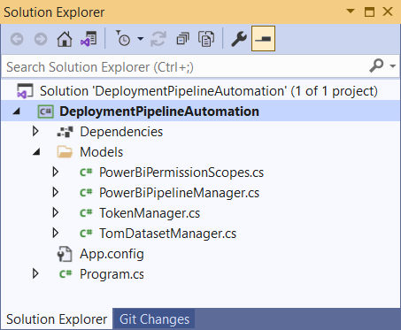
Developer Sample: DeploymentPipelineAutomation
aaaa

Slide 27
Agenda
Introduction to Deployment Pipelines
Building and Versioning Power BI Artifacts
Publishing Artifacts to the Power BI Service
Creating and Configuring Deployment Pipelines
Writing Code to Create and Manage Deployment Pipelines
Pipelines Roadmap

Slide 28
Creating a pipeline
New nav pane button
Only for organization with Premium capacities
Button will be hidden for end users
Assigning a workspace
The list will include only the following:
New workspace experience only
User is the admin of the WS
WS resides in a capacity
WS that isn’t already assigned to a pipeline
Only a single existing WS can be assigned to a pipeline

Slide 30
Permission model
View pipeline
Share with others
Edit & delete pipeline
Pipeline Access
View WS content
Compare stages
Deploy reports & dashboards
Update dataset
WS member
WS Admin
Assign/ remove WS
Configure rules
Dataset owner

Slide 31
Configuring Pipeline and Workspace Permissions
Show UI with one screen

Slide 32
Data Protection integration
Items with Sensitivity labels can be deployed
Orgs can mandate label usage alongside pipelines (coming soon)
Handling labels during deployment:
Deploying a new item- label will be copied
Updating an existing item- label will be retained
Exception- ‘protected’ item in source will make target item ‘protected’ as well.

Slide 33
WS members can update datasets
Previous behavior- only dataset owner can update
We are now aligned with ‘publish from Desktop permission.
Rules are still configured by dataset owner only

Slide 34
Agenda
Introduction to Deployment Pipelines
Building and Versioning Power BI Artifacts
Publishing Artifacts to the Power BI Service
Creating and Configuring Deployment Pipelines
Writing Code to Create and Manage Deployment Pipelines
Pipelines Roadmap

Slide 35
Deployment pipelines automation
Public Preview in May
Get pipelines info
Deployment APIs
Update App post-deployment
Service Principal support
PowerShell samples

Slide 36
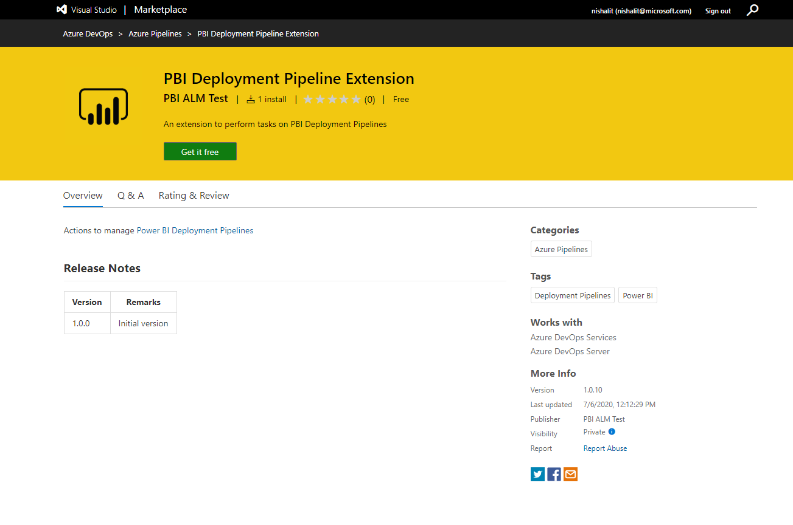
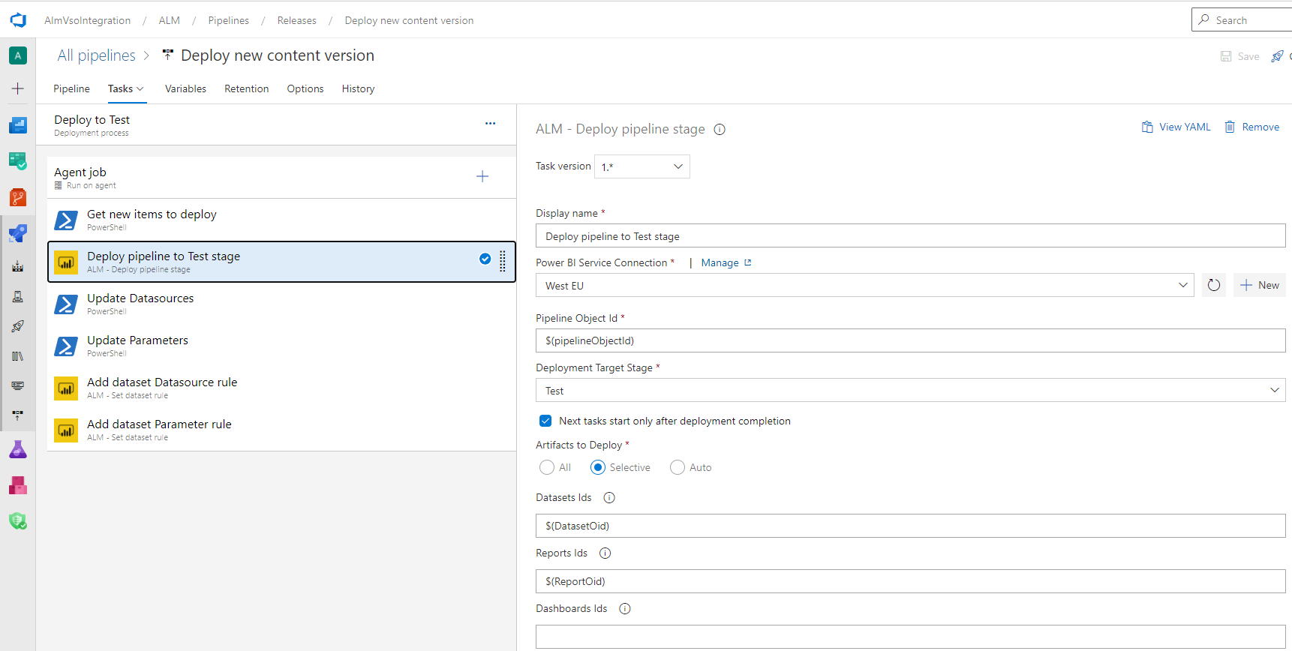
Deployment pipelines automation
Native extension- public preview in the summer
GA by end of semester
Create pipeline
Assign/ unassign WS
Add/ remove pipeline users

Slide 37
Deployment pipelines automation
overall_1_132241972397315101 columns_1_132241972397315101
Native extension- public preview is when ???
GA by end of semester
Create pipeline
Assign/ unassign WS
Add/ remove pipeline users

Slide 38
Agenda
Introduction to Deployment Pipelines
Building and Versioning Power BI Artifacts
Publishing Artifacts to the Power BI Service
Creating and Configuring Deployment Pipelines
Writing Code to Create and Manage Deployment Pipelines
Pipelines Roadmap

Slide 39

Multiple pipelines connection
Single pipeline
Dev
Test
Prod
DS A
DS A’
R A
R A’

Slide 40
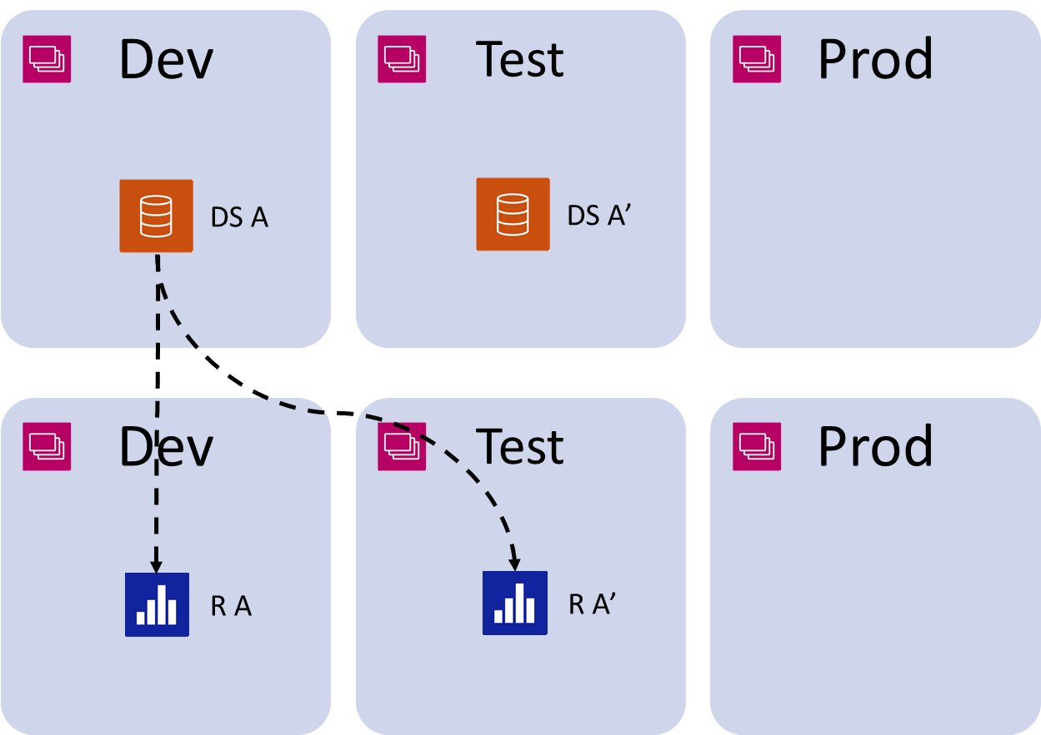
Multiple pipelines connection
Multiple pipelines

Slide 41
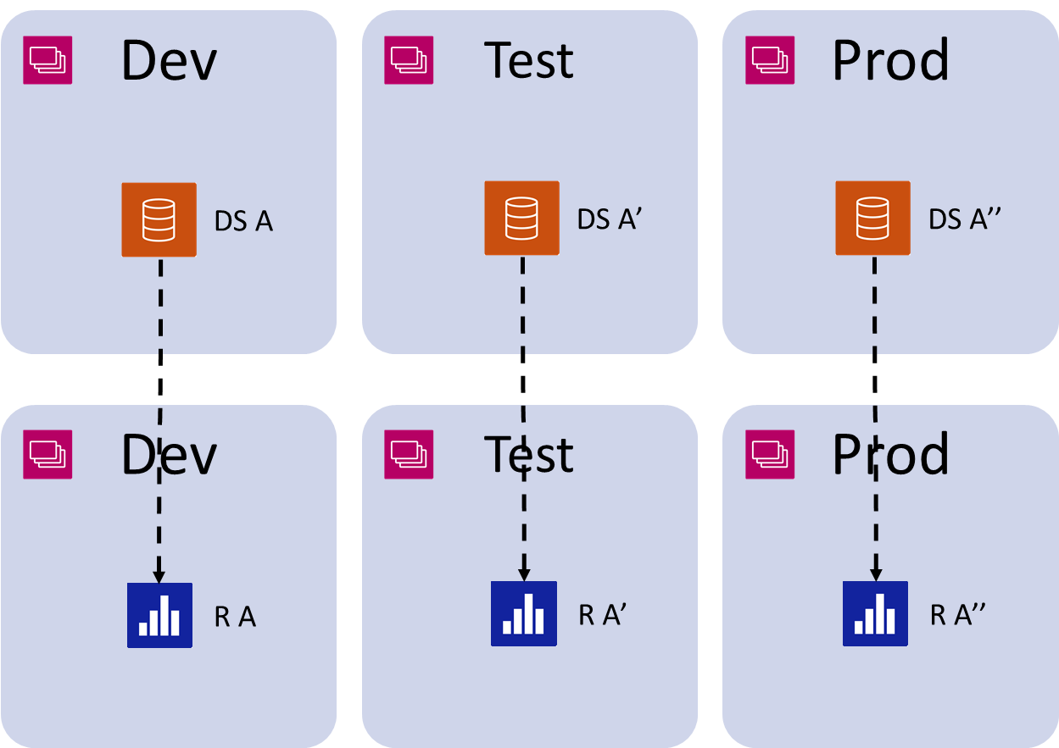
Multiple pipelines connection
Multiple pipelines

Slide 42
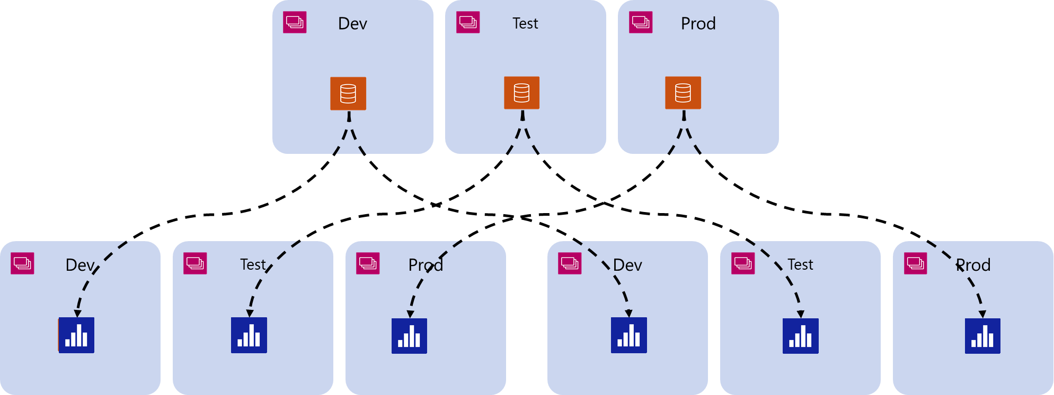
Multiple pipelines connection
Multiple pipelines

Slide 43
Other new features
Composite models support
Enabling major dataset updates

Slide 44
Summary
Introduction to Deployment Pipelines
Building and Versioning Power BI Artifacts
Publishing Artifacts to the Power BI Service
Creating and Configuring Deployment Pipelines
Writing Code to Create and Manage Deployment Pipelines
Pipelines Roadmap

Slide 45
Microsoft Power BI
Questions?

Slide 46
Data Protection integration
overall_1_132241972397315101 columns_1_132241972397315101
Items with Sensitivity labels can be deployed
Orgs can mandate label usage alongside pipelines
Deployment logic:
Deploying a new item- label will be copied
Updating an existing item- label will be retained
Exception- ‘protected’ item in source will make target item ‘protected’ as well.
Still missing- inheritance upon deployment
Notes:
- Missing ‘protection’ definition (is it encrypted?)

Slide 47
Enable major model updates
overall_1_132241972397315101 columns_1_132241972397315101
Current behavior- breaking changes in model would fail.
New behavior-
User gets a warning
He can choose to drop the data and continue the deployment
After deployment, a full refresh is required
Notes:
- Missing breaking changes examples

